Slide 1
Javascript Basic Exercises

Slide 2
Loops and Function basics
Write a function to render the following pattern in the console:
* * * * * * * * * * * * * * *
The function needs to take a number as a parameter which represents how many asterisks are rendered on the first row.

Slide 3
Objects
Define an object containing information about yourself. The object needs to include 'name', 'address', 'emails', 'interests' and 'education'. The 'education' key needs to be an array of objects containing keys 'name' and 'enrolledDate'.
Using the object defined previously iterate over the 'education' key and print a list of output in the console as follows:
Name: ABC School of Schoolery, Date: 2000
Name: BCD School of Trickery, Date: 2006

Slide 4
Objects
Write a function that searches for an object by a specific key value in an array of objects:
var fruits = [ {id: 1, name: 'Banana', color: 'Yellow'}, {id: 2, name: 'Apple', color: 'Red'} ] searchByName(fruits, 'apple');
Should return: {id: 2, name: 'Apple', color: 'Red'}
Also try searchByKey(fruits, 'name', 'apple');

Slide 5
Functions
Write a function that transforms an array of inputs into a new array based on a provided transformation function.
var numbers = [1, 2, 3, 4]; function transform(collection, tranFunc) { …TODO } var output = transform(numbers, function(num) { return num * 2; }); // output should be [2, 4, 6, 8]

Slide 6
Sorting
Write a program to sort an array of object by a target key. The original array should remain unchanged.
var arr = [{
id: 1,
name: 'John',
}, {
id: 2,
name: 'Mary',
}, {
id: 3,
name: 'Andrew',
}];
function sortBy(array, key) {
...
}
var sorted = sortBy(arr, 'name');

Slide 7
Normalization
Write a program to normalize a given input to get the expected output.
https://gist.github.com/nishanbajracharya/8fe38807b3ad074a7da2072c7b8e701b

Slide 8
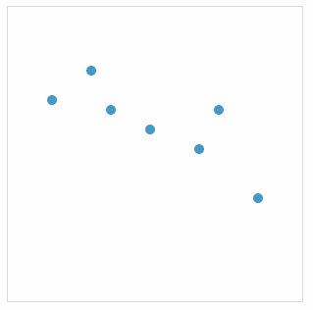
DOM
Render a scatter plot based on an array of coordinates. Create the container for the plot and create each point using javascript.
var points = [ {x: 10, y: 20}, {x: 40, y, 40}, {x: 60, y, 20}, ... ];

Slide 9
DOM - Animations
Render a circle that moves vertically and bounces back into another direction.

Slide 10
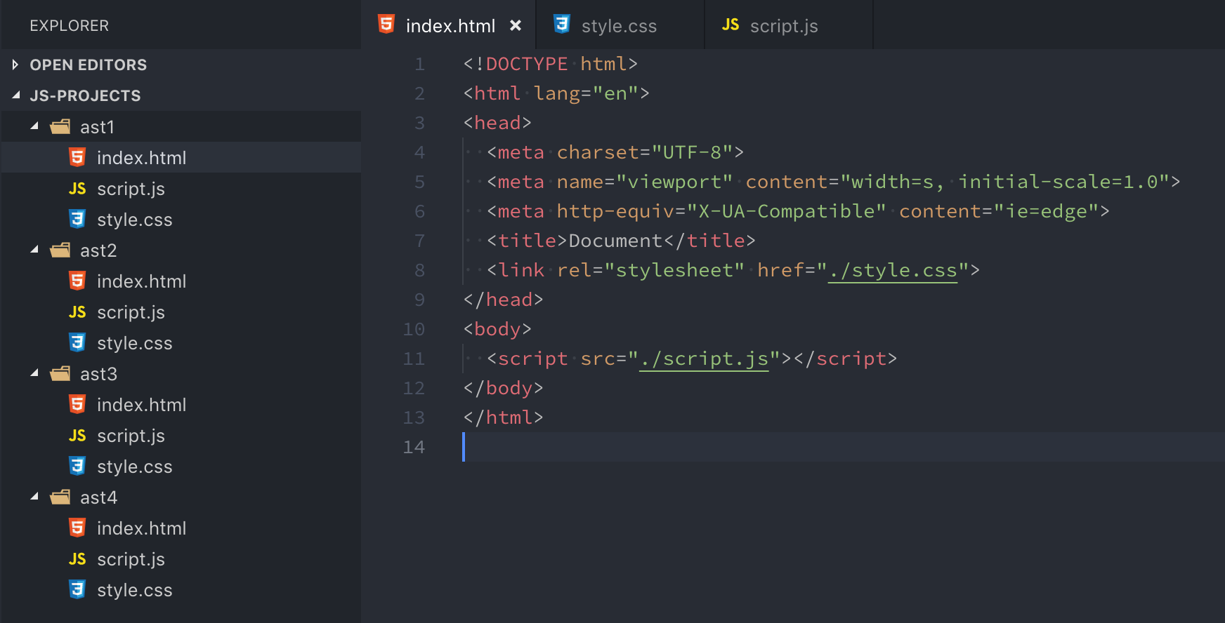
Assignments Folder Structure

Slide 11
Assignment 1 - Image Carousel
Write a program to generate an Image carousel. The slider needs to animate automatically over certain intervals and should contain forward and backward arrows and image indicator dots at the bottom.

Slide 12
Assignment 2 - Box/Ball Collision
Write a program that draws boxes or balls within a container. The balls should move in different directions and should collide with the walls and other balls.

Slide 13
Assignment 3 - Flappy Bird
Build Flappy Bird game

Slide 14
And that's it.

